Slide 1
Happy Wednesday
Take your name tag
Check in on iClicker

Slide 2

iClicker Question
What are the conditions for close-ended questions?
Exhaustive
Mutually Exclusive
Both

Slide 3

iClicker Question
What are the two opposite recall errors that we learned in the last class?
Telescoping error vs. Recall loss
Recall loss vs. Mandela Effect
Telescoping error vs. Mandela Effect

Slide 4
iClicker Question
Filter question is for the determination of appropriate informants and classification question is for segmentation
True
False

Slide 5
iClicker Question
There are both question order bias and response order bias
True
False

Slide 6
iClicker Question
In the flocking model, there is a special leader bird that leads the whole flock
True
False

Slide 7




Chapter 14: Developing the Sampling Plan
Notes:
So today we will go over chapter 14: Developing the sampling plan

Slide 8

Learning Objectives
Explain the difference between a parameter and a statistic
Explain the difference between a probability sample and nonprobability sample
List the primary types of nonprobability samples
List the primary types of probability samples
Cite 3 factors that influence the necessary sample size
Explain the relationship between population size and sample size
Notes:
Discuss the concept of total sampling elements (TSE)

Slide 9
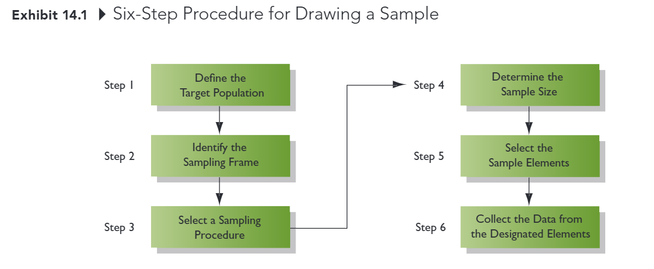
Developing the Sampling Plan
Notes:
There are six steps involving developing the sampling plan
We will go over each step in detail

Slide 10
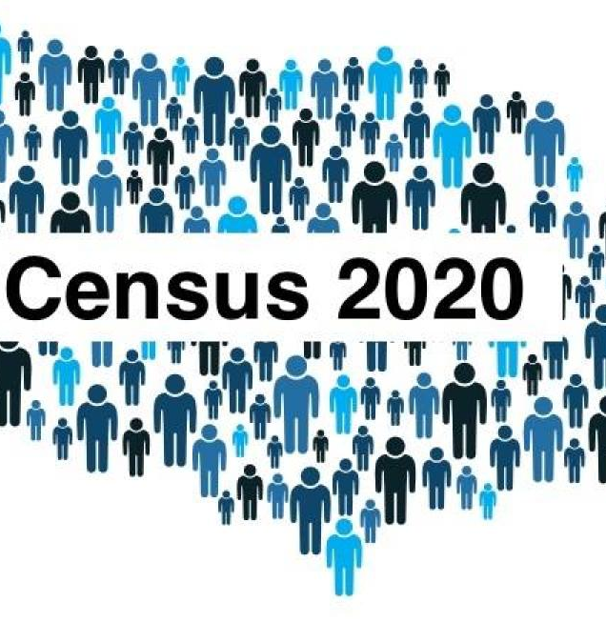
Step 1: Define the Targe Population
Population: All cases that meet designated specifications for membership in the group
Researchers must be very clear and precise in defining the population
Ex: Households in the city limits of Sacramento, CA, with on or more children under the age of 18 living at home.
Census: A type of sampling plan in which data are collected from or about each member of a population
Sample: Selection of a subset of elements from a larger group of objects
Notes:
A population is all cases that meet designated specifications for membership in the group.
Researchers must be clear and precise in defining the population.
For example, ….
On the other hand, census is a type of sampling plan in which data are collected from or about each member of a population.
And sample is selection of a subset of elements from a larger group of objects
Draw picture

Slide 11
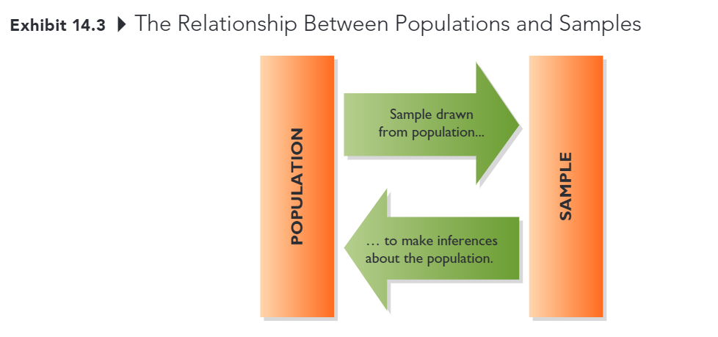
Step 1: Define the Target Population
Parameter: A characteristic or measure of population
Statistic: A characteristic or measure of a sample
We calculate statistics from sample data in order to estimate population parameters
Notes:
Since we can’t always do a census or in other words, we can’t survey everyone in a population
We usually just draw a random sample from the population to make inferences about the population.
So if you have a random sample, then your inference regarding the population should be accurate
So the characteristic or measure of population is called parameter,
While we call characteristic or measure of a sample statistic
Again, we calculate statistics from sample data to estimate population parameters.

Slide 12
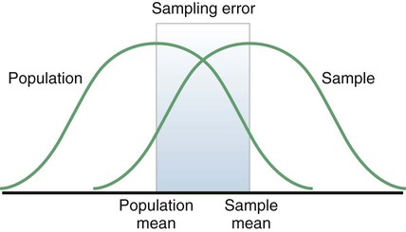
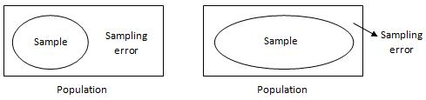
Sampling Error
Definition: The difference between results obtained from a sample and results that would have been obtained had information been gathered from or about every member of the population
Deceased by increasing sample size
Can be estimated (assuming probability sample) usually less troublesome than other kinds of error
Notes:
So the difference between results obtained from a sample and results that would have been obtained had information been gathered from or about every member of the population is called sampling error
Say that we draw a random sample of people from the US population, then you will ask them how many time they purchase Coke last week?
Then you can make inferences regarding how many coke an average US person would consume
So how can we decrease sampling error?
You can decrease your sampling error by increasing sample size, because as you approach the actual size of the population, your sample will resemble your population more.
Sampling error can be estimated using a formula unlike other errors such as measurement errors

Slide 13
Step 2: Identify the Sampling Frame
Sampling Frame
The list of population elements from which a sample will be drawn; the list could consist of geographic areas, institutions, individuals, or other units
Commonly used sampling frames: customer database, member directories, list developed by data compilers
Notes:
In the step 2, you will identify the sampling frame
So sampling frame is the list of population elements from which a sample will be drawn,
This list could consist of geographic areas, institutions, individuals, or other
So commonly used sampling frames can be customer database
Just think of sampling frame as how you define your sample
Is there any questions?

Slide 14
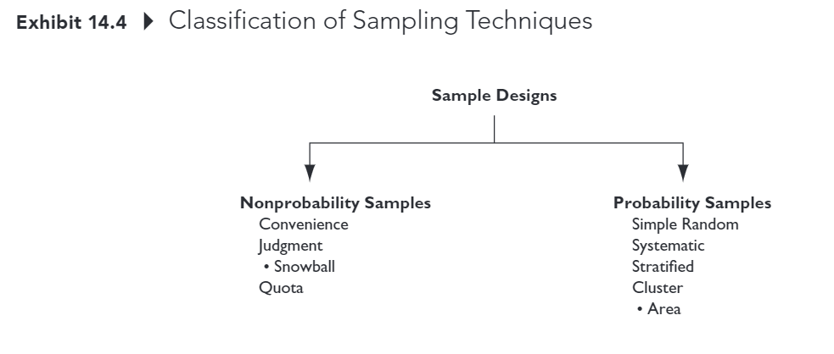
Step 3: Select a Sampling Procedure
Notes:
Then in step 3, you can select your sampling procedure
There are two classifications of sampling techniques
The first one is non-probability samples
And the second one is probability sample

Slide 15
Step 3: Select a Sampling Procedure
Nonprobability sample
A sample that relies on personal judgment in the element selection process
With nonprobability samples, sampling error cannot be estimated and we cannot calculate the margin of sampling error
Example:
Convenience
Judgment (e.g., snowball)
Quota
Notes:
So the definition of non-probability sample is a sample that relies on personal judgment in the element selection process
But the downturn of non-probability sample is that you can’t estimate the sampling error, and margin of sampling error
Examples of nonprobability sample are convenience sampling, judgment sampling, or quota sampling

Slide 16
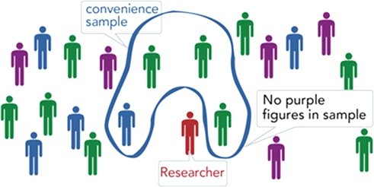
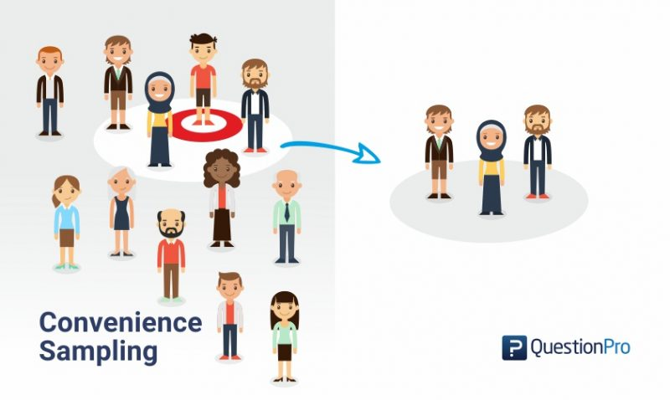
Step 3: Select a Sampling Procedure
Convenience Sample: A sample in which population elements are included in the sample because they were readily available
Sometimes referred to as “accidental” sampling; population elements are sampled simply because they are in the right place at the right time
Easy to conduct, but no way to know if sample is representative of the population (i.e., cannot statistically assess sampling error)
Notes:
So convenience sample is a sample in which elements are included in the sample because they were readily available.
This method is easy to conduct, …
A nonparaxiality sample in which population elements are included in the sample because they were readily available

Slide 17
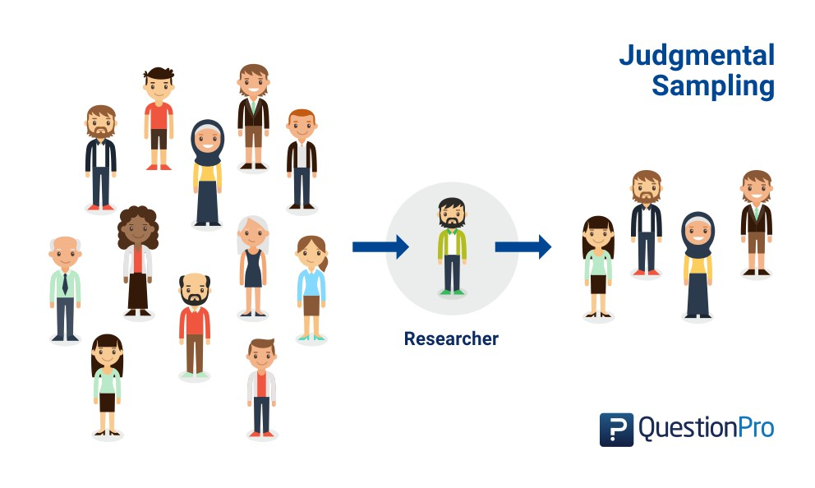
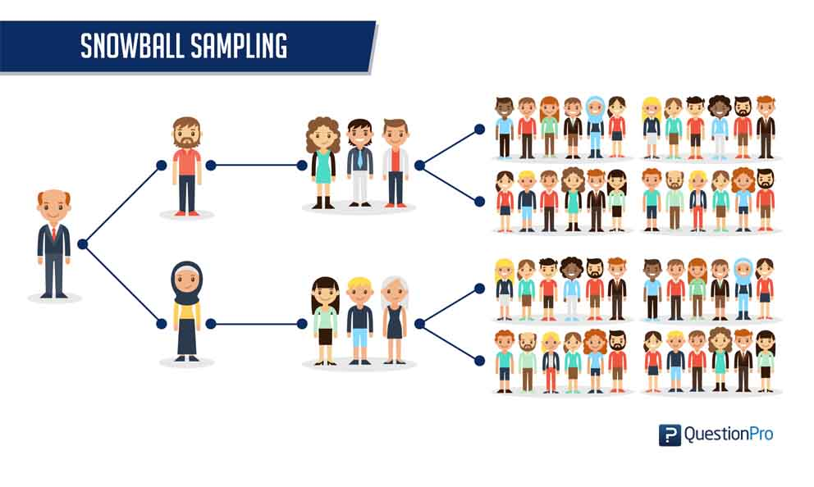
Step 3: Select a Sampling Procedure
Judgment Sample: A nonprobability sample in which the sample elements are handpicked because they are expected to serve the research purpose
The researcher may believe that the sample elements are representative of the larger population or that they can offer the information needed
A snowball sample is one form of judgment sample
Notes:
Explain snowball: for example conspiracy group
Or HIV study

Slide 18
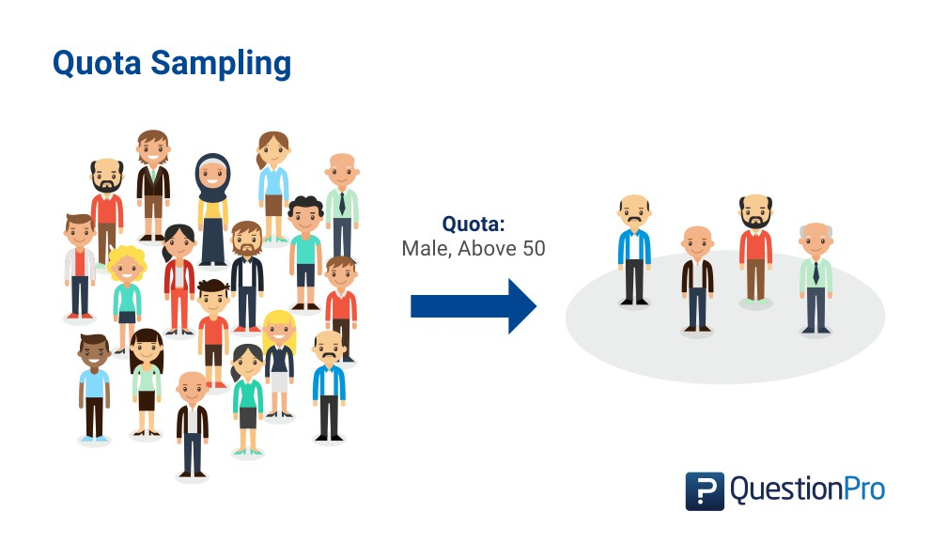
Step 3: Select a Sampling Procedure
Quota Sample: A nonprobability sample chosen so that the proportion of sample elements with certain characteristics is about he same as the proportion of the elements with the characteristics in the target population
A “quota” representing these characteristics is established so that when the sample is complete it will mirror the population on the key characteristics
Notes:
Another non-probability sampling procedure is quota sampling, which is …

Slide 19
Quota Sampling Example
Research Problem:
Investigate undergraduate student attitudes toward controversial technology fee
Known population parameters class (30% FR, 20% SO, 30% JR, 20% SR) and gender (50% male, 50% female)
10 students will interview 10 friends each
What should be the composition (class and gender) of those 100 students?
Notes:
Another quota example is that when you have a research problem to investigate undergrad student attitude toward controversial technology fee.
You know that the population parameters class are 30% …
(e.g., 25 males between he ages of 20 and 29; 25 females between the ages of 20 and 29; 35 males between the ages of 30 and 39; etc)

Slide 20
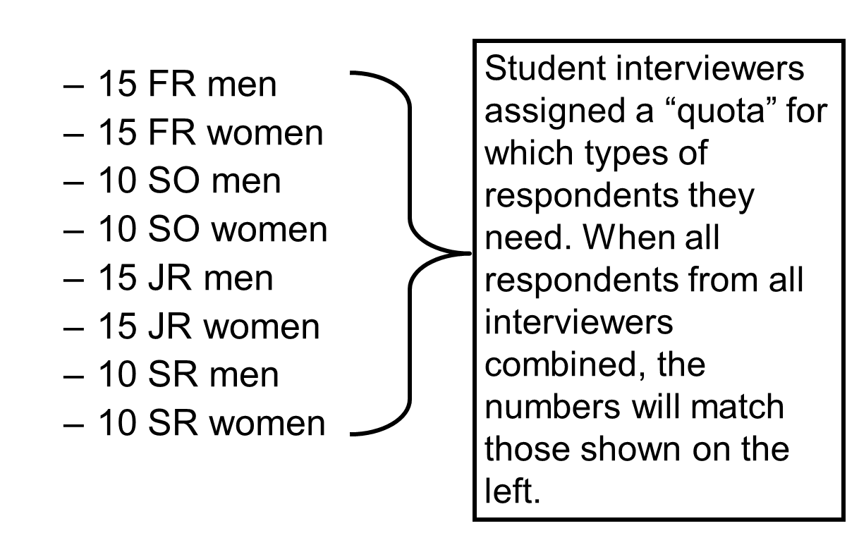
Quota Sampling Example
Notes:
15 MFR, 15 FFR,
10 MSO, 10 FSO
15 MJR, 15, FJR
10 MSR, 10 FSR

Slide 21
Probability
Probability Sample: A sample in which each target population element has a known, nonzero chance of being included in the sample
With probability samples there is a random component to which elements are elected; sampling error can be estimated
Simple random
Systematic
Stratified
Cluster (including area)
Notes:
The second type of sampling method is probability sampling which will give you a sample in which each target population element has a known, nonzero chance of being included in the sample
This basically mean that each target population has a chance of being included in the sample
With probability samples….
There are 4 types of probability sampling

Slide 22
Why use Probability Sampling?
Because the analyst can statistically assess the level of sampling error and make projections to the population
Just don’t forget that sampling error is only one kind of error, and it usually isn’t the biggest problem)
Notes:
So why do you think we want to use probability sampling?

Slide 23
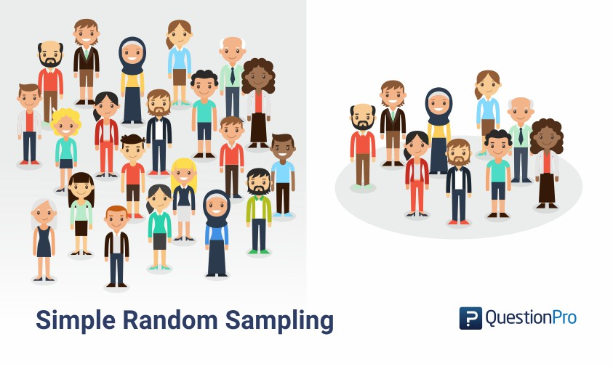
Simple Random Sample
A probability sampling plan in plan in which each unit included in the population has a known and equal chance of being selected for the sample.
If a digital version of the sampling frame is available, implementing a simple random sample is relatively easy
Notes:
The first type of probability sampling is simple random sampling in which each unit included in the population has a known and equal chance of being selected for the sample
The hard part of simple random sample is that you have to make sure everyone has an equal chance of being selected
If for example rich families are more likely to be selected for the educational lottery ticket, then you don’t have simple random sample.

Slide 24
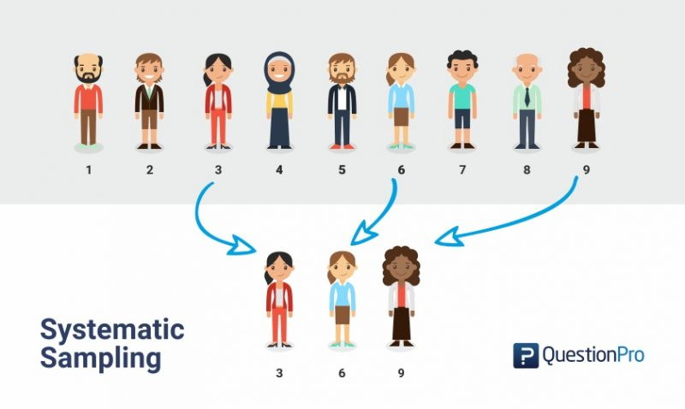
Systematic Sample
Systematic Sample: A probability plan in which every k-th element in the population is selected from the sample pool after a random start
If a digital version of the sampling frame is NOT available, but a list of population members exists, this is a useful approach
Notes:
Another type of probability sampling is systematic sampling in which every k-th element in the population is selected from the sample pool after a random start
May be every 6th person from a list will be selected

Slide 25

Sample Interval Formula
Sampling Interval (k)
The number of population elements to count (k) when selecting the sample members in a systematic sample
$k=\frac{\left\{\#elements in sampling frame\right\}}{\left\{total sampling elements\right\}}$
Notes:
To determine the number k, we use the following formula …
We will go into the denominator first

Slide 26

Total Sampling Elements
Total Sampling Elements (TSE)
The number of population elements that must be drawn from the population and included in the initial sample pool in order to end up with the desired sample size
$TSE=\frac{\left\{sample size\right\}}{\left\{(1−BCI)(1−I)(1−R)(1−NC)\right\}}$
BCI = proportion of bad contact information
I = proportion of ineligible elements
R = proportion of refusals
NC = proportion that cannot be contacted after repeated attempts
Notes:
SO total sampling elements is the number of population elements you must draw to approximately get your desired sample size
So this is the formula
We will try one example

Slide 27
TSE Example
You will be conducting a telephone survey of university students who are 21 years of age or older. You have determined that a sample size of 250 will allow reasonable precision and confidence for your estimates of important population parameters. Let’s assume that
15% of the telephone numbers aren’t working,
2% of students you contact are ineligible because they have working telephone numbers but have left the school
about 20% of students will refuse to participate
you will be unable to reach 30% of those selected for the sample
(BCI=0.1, I=0.02, R=0.20, NC=0.30).
How many sampling elements should you include in the project?
Notes:
Total sampling element?

Slide 28

Systematic Sampling Example
$k=\frac{\left\{\#elements in sampling frame\right\}}{\left\{total sampling elements\right\}}$
$TSE=\frac{\left\{sample size\right\}}{\left\{(1−BCI)(1−I)(1−R)(1−NC)\right\}}$
Knowing that you need a sample pool of 536 students to ultimately get about 250 students in your sample, you are in position to draw a systematic sample form the student directory at your university. Further, 5,000 students are listed in the directory
What is the sampling interval?
What is the number of desired sample size?
250
What is the number of total sampling elements?
536
What is number of elements in sampling frame?
5000
Notes:
So now go back to calculating k, which is the sampling interval
Knowing that you need a sample pool of …
So what is the number of desired sample size ? 250
What is the number of total sampling elements? 536
What is number of elements in sampling frame? 5000
What is the sampling interval

Slide 29

Systematic Sampling Example
$K=\frac{\left\{\#elements in sampling frame\right\}}{\left\{total sampling elements\right\}}=\frac{5000}{536}=9.3$
Randomly select one of the first 9 students and select every 9th students after to be in the initial sampling pool

Slide 30
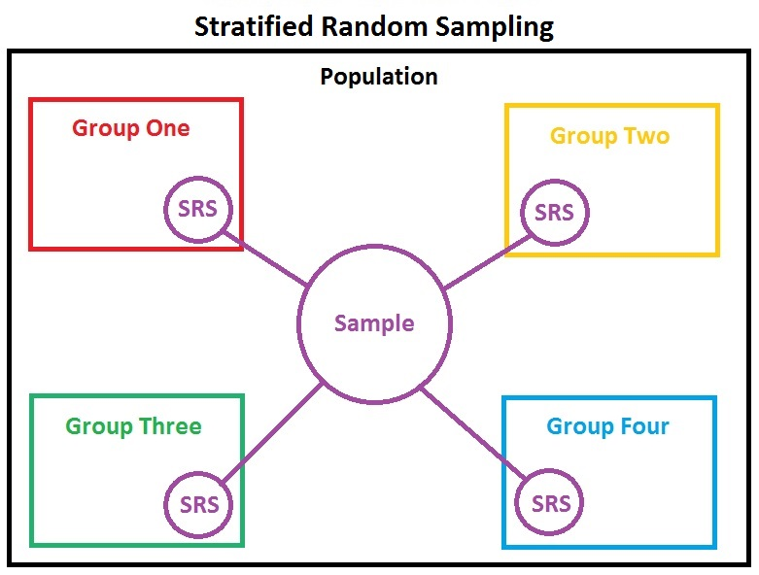
Stratified Sample
A probability sample in which
The population is divided into mutually exclusive and exhaustive subsets
A probabilistic sample of elements is chosen independently from each subset
Most appropriate when strata are homogeneous within but heterogenous between with respect to key variable(s)
Decreased variance within strata on key variable(s) means increased precision
Ability to ensure that important strata are represented
This Photo by Unknown Author is licensed under CC BY-SA
Notes:
The next probability sample is stratified sample in which …
Example second point.
So with homogenous within and heterogenous between strata, we can decrease variance within strata
consider a situation where a research team is seeking opinions about religion amongst various age groups. Instead of collecting feedback from 326,044,985 U.S citizens, random samples of around 10000 can be selected for research. These 10000 citizens can be divided into strata according to age,i.e, groups of 18-29, 30-39, 40-49, 50-59, and 60 and above. Each stratum will have distinct members and number of members.

Slide 31
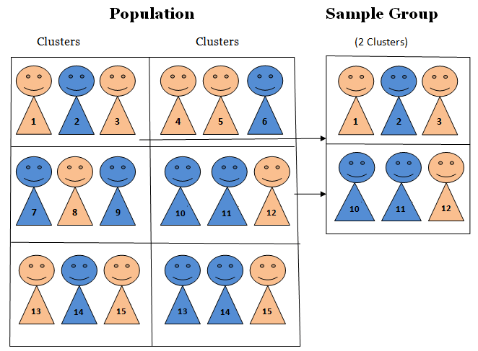
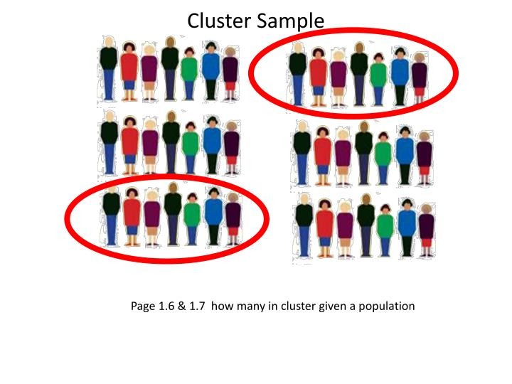
Cluster Sample
A probability sample in which
(1) the parent population is divided into mutually exclusive and exhaustive subsets
(2) a random sample of one or more subsets (clusters) is selected
Strata should be heterogeneous within, homogeneous between
An AREA SAMPLE is a form of cluster sampling in which areas (e.g., census tracts, blocks) serve as the primary sampling units
Notes:
The last type of probability sample that we will cover is cluster sample in which …

Slide 32
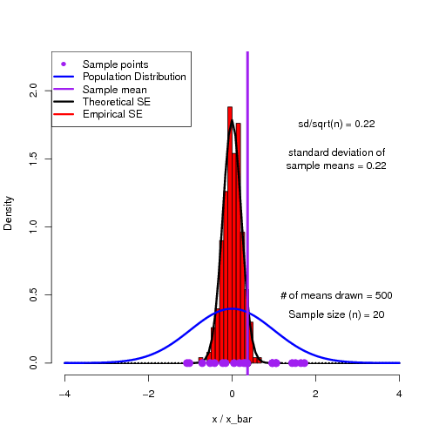
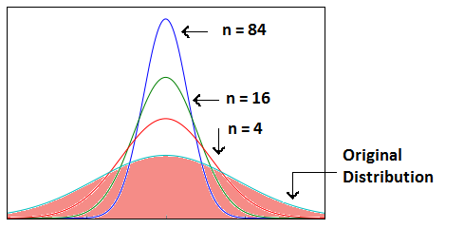
Step 4: Determine the Sample Size
To determine the necessary sample size, we need 3 pieces of info:
How homogeneous (similar) the population is on the characteristic to be estimated
How much precision is needed in the estimate
How confident we need to be that the true value falls within the precision range established
Precision: the degree of error in an estimate of a population parameter
Confidence: the degree to which one can feel confident that an estimate approximates the true value
Precision and confidence are inversely related: as one increases, the other decreases, all else equal
Notes:
In step 4, we need to determine the sample size,
Recall when calculating k, we kinda assume that we know our desired sample size
Now we will learn how to estimate our desired sample size
To determine the necessary sample size, we need..
A choice for a higher confidence level (99%) will lead to a wider confidence interval, and thus to a less precise estimate

Slide 33

Determining Sample Size when Estimating Means
$n=\frac{z^{2}}{H^{2}} \hat{σ^{2}}$
Where
n = required sample size
z = z-score corresponding to the desired degree of confidence
H = half-precision (i.e., how far off the estimate can be in either direction)
$σ^{2}$ = variance of the variable in the population

Slide 34

Determining Sample When Estimating Means
When is it meaningful to calculate a mean
Interval Scales
Ratio Scales
You have been asked to determine the average amount that fishermen spend per year on food and lodging while on fishing trips in a certain state. Your estimate is to be within + / - $25 of the population mean; the confidence level is to be 95% and the estimated standard deviation for the amount spent is $125 based on prior research. Thus…
H = $25
Z = 1.96
$σ=\$125$
Notes:
If you recall, mean calculation is only applied to interval and ratio scales.
Here is an example …

Slide 35

Determining Sample When Estimating Means
How large a sample do you need?
$n=\frac{z^{2}}{H^{2}}\left(\hat{σ^{2}}\right)=\frac{{1.96}^{2}}{{25}^{2}}{125}^{2}=96$
Notes:
Then you can plug into our formula to find your desired sample

Slide 36

Determining Sample When Estimating Proportions
$n=\frac{z^{2}}{H^{2}}π\left(1−π\right)$
Where
n = required sample size
z = z-score corresponding to the desired degree of confidence
H = half-precision (i.e., how far off the estimate can be in either direction)
$π=$estimated population proportion

Slide 37

Determining Sample When Estimating Means
When do we sue the proportion formula for sample size calculation?
Nominal scales
Ordinal scales
You have been asked to determine the proportion of all out-of-state fishermen who took at least one overnight fishing trip in the past year. Your estimate is to be within +/- 2% of the population mean; the confidence level is to be 95%;l and the best guess is that 25% of out-of-state respondents have taken at least one overnight fishing trip. Thus..
H = 2%
Z = 1.96
$π=$25%

Slide 38

Determining Sample When Estimating Means
How large a sample do you need?
$n=\frac{z^{2}}{H^{2}}π\left(1−π\right)=\frac{{1.96}^{2}}{{0.02}^{2}}.25\left(1−.25\right)=1800$

Slide 39

Population Size and Sample Size
Unless the sample will be more than 5-10% of the population size, the size of the population does not enter into the calculation of the size of the sample
Many people, including managers, have trouble with this idea.
Notes:
Whether the true population is 1,000 or 10,000 or 100k, it doesn’t matter.

Slide 40

Finite Population Sample Size
For use when sample size > 10% of the population size
For means: $n=\frac{\left\{σ^{2}\right\}}{\left\{\frac{H^{2}}{Z^{2}}+\frac{σ^{2}}{N}\right\}}$
For proportions: $n=\frac{\left\{π\left(1−π\right)\right\}}{\left\{\frac{H^{2}}{Z^{2}}+\frac{π\left(1−π\right)}{N}\right\}}$
Notes:
So in the case that the calculated sample size is more than 10% of the population size, then we have to refine our estimated sample size by these two formula.

Slide 41
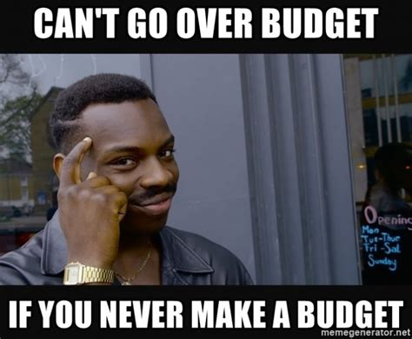

Other approaches to determining sample size
Size of research budget
Anticipated analyses
Historical practice
Notes:
But these methods are rather unscientific and based largely on human intuition (which is flawed)

Slide 42
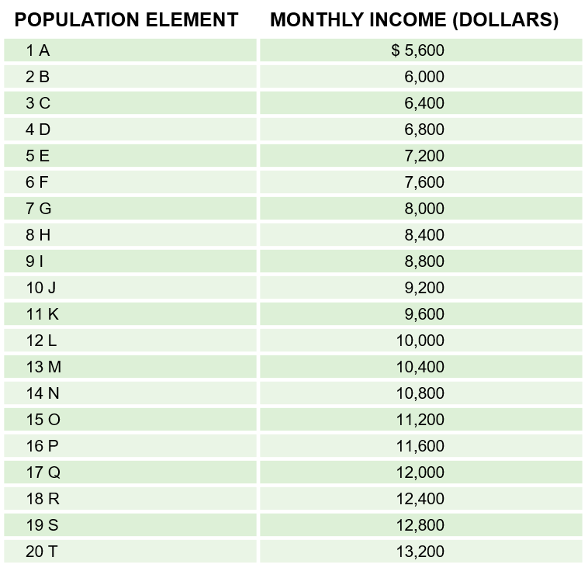
Basics of the Sampling Distribution
EXHIBIT 14A.1 Population
Population Mean (μ) = $9400

Slide 43
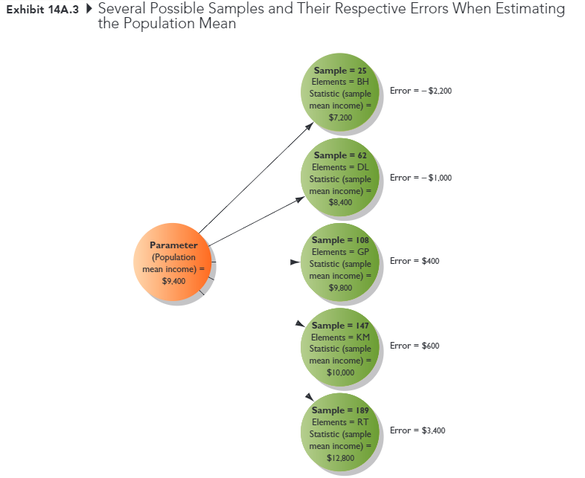
Basics of the Sampling Distribution
Derived population
All possible sample that can be drawn from the population under a given sampling plan

Slide 44
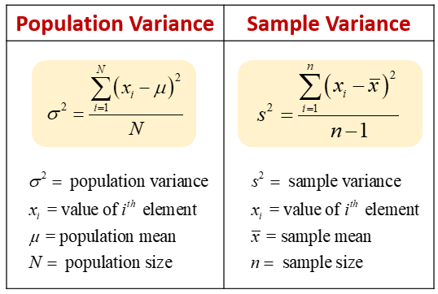
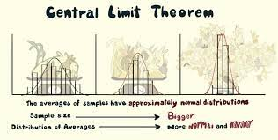
Basics of the Sampling Distribution
The mean of all possible sample means is equal to the population mean
The variance of the sample means is related to the population variance
The sampling distribution is mound shaped
Consistent with the Central-Limit Theorem, regardless of the shape of the distribution of the variable in the population, with a sample size of 30, the distribution of sample means becomes normally distributed

Slide 45
Questionnaire Analysis
Notes:
Now we get back to our questionnaire analysis
(Chapter 13 continue)

Slide 46
Exchange Questionnaire
15 mins to exchange questionnaire across groups
10 mins to discuss changes with your group
Notes:
Pair up with another group (we have 6 groups in this class)
Exchange your survey, fill it out, and discuss, critique and fill out questionnaire worksheet B

Slide 47
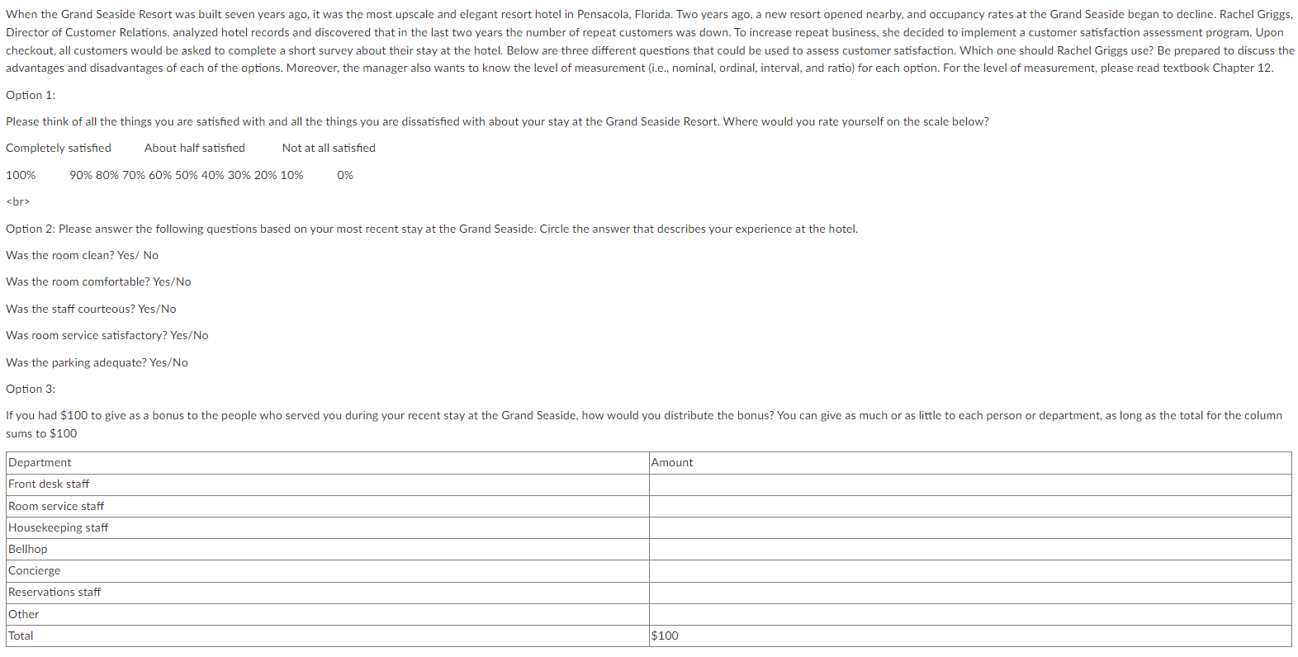
Discussion Case #5
Notes:
In case 5, you want to assess your customer satisfaction. And there are 3 options. You have to discuss the advantages and disadvantages of each of them
For example, the first option could be rather short and fast, which might increase your response rate. While the second and third are more detail and give you more information, but the attribution rate might be higher than the first one. Moreover, the third option is the constant-sum method which is under comparative-rating scale, which will give you the relative importance among different attributes.
So please discussion all of the options and how this question relates to the textbook chapter. I don’t want you to miss points regarding how this question relates to the textbook chapter.

Slide 48
Up next
Assignment 4 (Sunday)
Quiz 6 (Sunday)
Discussion Case #5 (Sunday)
Read Chapter 15

Slide 49
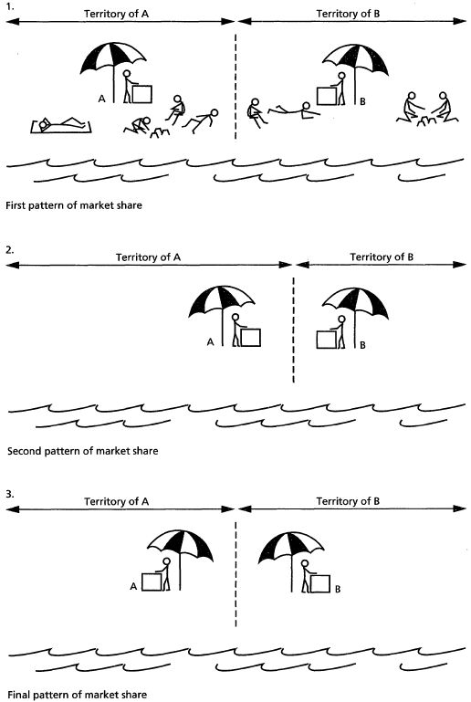
5-min snippet: Hotelling’s Law
Netlogo link
Try:
Plane vs. Line
Moving vs. Price rule
More than 2 players
Notes:
This model is a representation of Hotelling's law (1929), which examines the optimal placement of stores and pricing of their goods in order to maximize profit. In Hotelling's original paper, the stores were confined to a single dimension. This model replicates and extends Hotelling's law, by allowing the stores to move freely on a plane.
Present subdiscipline in marketing
Seminal paper that stems a lot of analytical model in econ (game theory branch)
My own research (analytical model)
In this model, several stores attempt to maximize their profits by moving and changing their prices. Each consumer chooses their store of preference based on the distance to the store and the price of the goods it offers.
Each consumer adds up the price and distance from each store, and then chooses to go to the store that offers the lowest sum. In the event of a tie, the consumer chooses randomly. The stores can either be constrained to one dimension, in which case all stores operate on a line, or they can be placed on a plane. Under the normal rule, each store tries to move randomly in the four cardinal directions to see if it can gain a larger market share; if not, it does not move. Then each store checks if it can earn a greater profit by increasing or decreasing the price of their goods; if not, it does not change the price. This decision is made without any knowledge of their competitors' strategies. There are two other conditions under which one can run this model: stores can either only change prices, or only move their location.

